Slide 1
NATIONAL ASSOCIATION OF CLINICAL PSYCHOLOGISTS (NACP) CONFERENCE - BAZE UNIVERSITY ABUJA
CONTINUOUS EDUCATION WORKSHOP ( 21st - 22nd November 2022)
ON
MMPI-2 ADMINISTRATION AND SCORING
PRESENTATION
BY
Gloria S. Karuri Ph.D
Professor of Clinical Psychology
Department of General and Applied Psychology
Faculty of Social Sciences.
University of Jos. Plateau Sate.
karuri310@gmail.com & karurig@unijos.edu.ng

Slide 2
MMPI-2 ADMINISTRATION AND SCORING
MMPI-2 a 567 item self report, measures personality and psychopathology
Consists of the following scales
Eight (8) validity scales
Ten (10) Clinical scales
Fifteen (15) Content scales
Others include:
Fifteen (15) supplementary scales
Twenty-eight (28) Harris-Lingoes subscales
Three Social Introversion scales
Twenty-seven Content Component scales
Nine (9) Restructured Clinical (RC) Scales
Personality Psychopathology-Five scales (PSY-5)

Slide 3
MMPI-2 ADMINISTRATION AND SCORING
REASONS FOR TEST
Identify Psychopathology
Develop treatment plans
Assist with differential diagnosis
Part of therapeutic assessment
Help answer legal questions
Child custody disputes
Personnel selection/ screening
Substance abuse programmes
Evaluate the thoughts, feelings, attitudes, and behaviours that make up one’s personality

Slide 4
MMPI-2 ADMINISTRATION AND SCORING
WHAT TO CONSIDER
Client’s background
Family history
Medical History
Mental health history
Culture
Gender
Age
Ethnicity/Race
Referral source
Educational/Economic etc. status
Severity/Level of Psychopathology

Slide 5
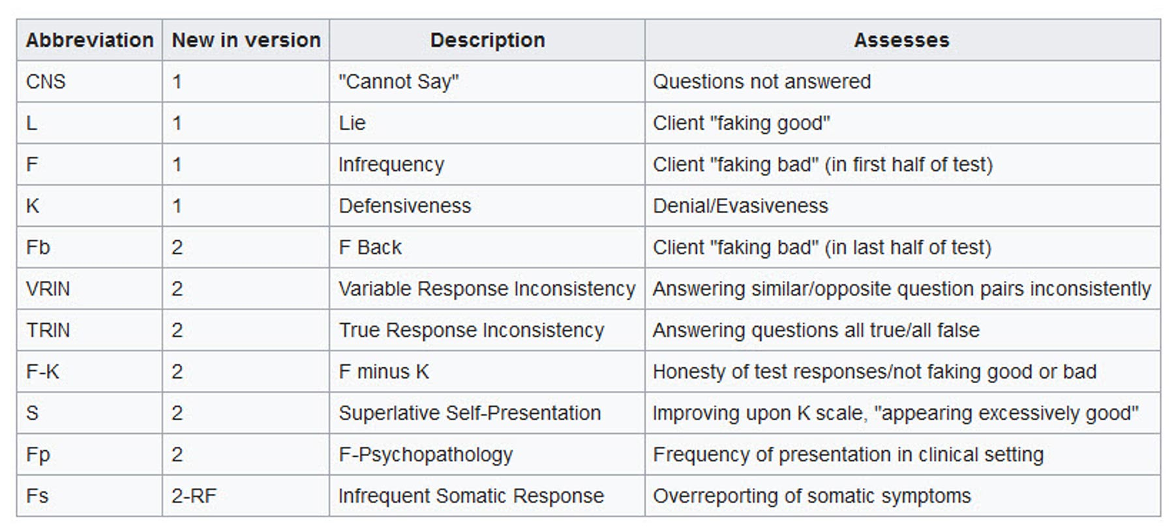
MMPI-2 SCALES - Eight (8) validity scales

Slide 6
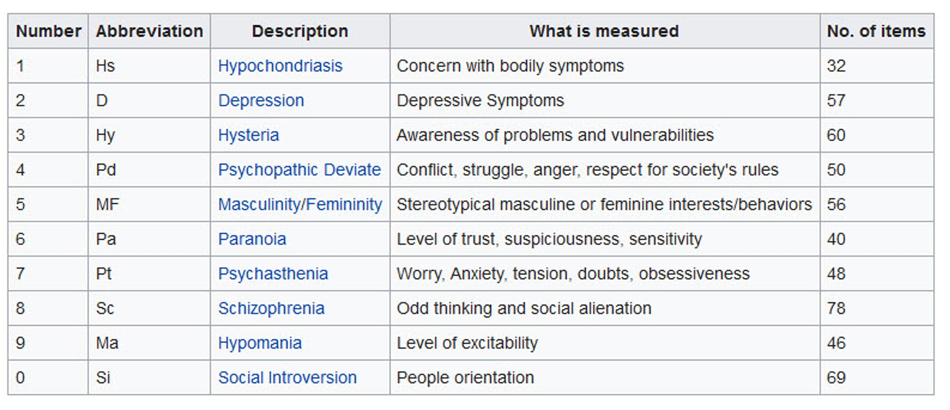
MMPI-2 SCALES - Ten (10) Clinical scales

Slide 7
MMPI-2 SCALES - Fifteen (15) Content scales
table
S/no | ABBREVIATION | DESCRIPTION | WHAT IT MEASURES | NUMBER OF ITEMS
1 | ANX | ANXIETY |  | 23
2 | FRS | FEARS |  | 23
3 | OBS | OBSESSIONS |  | 16
4 | DEP | DEPRESSION |  | 33
5 | HEA | HEALTH CONCERNS |  | 36
6 | BIZ | BIZARRE MENTATION |  | 24
7 | ANG | ANGER |  | 16
8 | CYN | CYNICISM |  | 23
9 | ASP | ANTISOCIAL PRACTICES |  | 22
10 | TPA | TYPE A |  | 19
11 | LSE | LOW SELF-ESTEEM |  | 24
12 | SOD | SOCIAL DISCOMFORT |  | 24
13 | FAM | FAMILY PROBLEMS |  | 25
14 | WRK | WORK INTERFERENCE |  | 33
15 | TRT | NEGATIVE TREATMENT INDICATORS |  | 26

Slide 8
MMPI-2 SCALES
12 of 15 CONTENT SCALES PRODUCED 27 CONTENT COMPONENT SCALES
FEARS Subscales
• Generalized Fearfulness (FRS1) 12 items
• Multiple Fears (FRS2) 10 items
Depression Subscales
• Lack of Drive (DEP1) 12 items
• Dysphoria (DEP2) 6 tems
• Self-.‐Deprecia9on (DEP3) 7 items
• Suicidal Idea9on (DEP4)5 items
Health Concerns Subscales
• Gastrointestinal Symptoms (HEA1) 5 items
• Neurological Symptoms (HEA2) 12 items
• General Health Concerns (HEA3) 6 items
Bizarre Mentation Subscales
• Psychotic Symptomatology (BIZ1)11 items
• Schizotypal Characteristics (BIZ2) 9 items
Anger Subscales
• Explosive Behaviour (ANG1) 7 items
• Irritability (ANG2) 7 items 12

Slide 9
12 of 15 CONTENT SCALES PRODUCED 27 CONTENT COMPONENT SCALES
Cynicism Subscales
• Misanthropic Beliefs (CYN1) 15 items
• Interpersonal Suspiciousness (CYN2) 8 items
Antisocial Practices Subscales
• Antisocial Attitudes (ASP1)16 items
• Antisocial Behaviours (ASP2) 5 items
Type A Subscales
• Impatience (TPA1) 6 items
• Competitive Drive (TPA2) 9 items
Low Self-.‐Esteem Subscales
• Self-.‐Doubt (LSE1) 11 items
• Submissiveness (LSE2) 6 items

Slide 10
12 of 15 CONTENT SCALES PRODUCED 27 CONTENT COMPONENT SCALES
Social Discomfort Subscales
• Introversion (SOD1) 12 items
• Shyness (SOD2) 7 items 13
Family Problems Subscales
• Family Discord (FAM1) 12 items
• Familial Aliena9on (FAM2) 5 items
Negative Treatment Indicator Subscales
• Low Motivation (TRT1) 11 items
• Inability to Disclose(TRT2) 5 items
• Motivation (TRT1) 11 items
• Inability to Disclose (TRT2)

Slide 11
Fifteen (15) Supplementary scales
S/no | GROUPINGS OF SUPPLEMENTARY SCALES | S/no | WHAT IT MEASURES
1 | GENERALIZED EMOTIONAL DISTRESS SCALES | 1 | Anxiety A
 |  | 2 | College Maladjustment (Mt)
 |  | 3 | Post traumatic Stres Disorder (PTSD)
 |  | 4 | Marital Distress (MDS)
2 | BROAD PERSONALITY CHARACTERISTICS | 1 | Regression ( R)
 |  | 2 | Ego Strength (Es)
 |  | 3 | Dominance (DO)
 |  | 4 | Social Responsibility (Re)
3 | BEHAVIOURAL DISCONTROL | 1 | Hostility (Ho)
 |  | 2 | Over-controlled Hostility (O-H)
 |  | 3 | MacAndrew Alcoholism - Reversed (MAC-R)
 |  | 4 | Addiction Admission Scale (AAS)
 |  | 5 | Addiction Potential Scale (APS)
4 | GENDER ROLES | 1 | Gender Role - Masculinity (GM)
 |  | 2 | Gender Role - Feminine (GF)

Slide 12
PERSONALITY PSYCHOPATHOLOGY - FIVE (BIG-5)
(VARIANTS OF NORMAL PERSONALITY)
s/no | DESCRIPTION
1 | EXTRAVERSION
2 | NEUROTICISM
3 | AGREEABLENESS
4 | CONSCIENCIOUSNESS
5 | OPPENNESS TO EXPERIENCE
NOTE: (Costa, Widiger, and the Five Factor Model based on Lexical Approach - Allport)

Slide 13
Harris-Lingoes Subscales
D1 - Subjective Depression D2 - Psychomotor Retardation D3 - Physical Malfunctioning D4 - Mental Dullness D5 - Brooding Hy1 - Denial of Social Anxiety Hy2 - Need for Affection Hy3 - Lassitude-Malaise Hy4 - Somatic Complaints Hy5 - Inhibition of Aggression Pd1 - Familial Discord Pd2 - Authority Problems Pd3 - Social Imperturbability Pd4 - Social Alienation Pd5 - Self-Alienation

Slide 14
Harris-Lingoes Subscales
Pa1 - Persecutory Ideas Pa2 - Poignancy Pa3 - Naïveté
Sc1 - Social Alienation Sc2 - Emotional Alienation Sc3 - Lack of Ego Mastery-Cognitive Sc4 - Lack of Ego Mastery-Conative Sc5 - Lack of Ego Mastery-Defective Inhibition Sc6 - Bizarre Sensory Experiences Ma1- Amorality Ma2- Psychomotor Acceleration Ma3- Imperturbability Ma4- Ego Inflation
Social Introversion Subscales Si1 - Shyness / Self-Consciousness Si2 - Social Avoidance Si3 - Alienation - Self and Others

Slide 15
MMPI-2 Restructured Clinical (RC) SCALES Descriptions
1st to quide clinical scale interpretation; Now interpreted as a primary source of information
RCd - Demoralization > General dissatisfaction, unhappiness, hopelessness,
self-doubt, inefficacy
RC1 - Somatic Complaints > Self-reported neurological, gastro-intestinal, and pain-
related complaints
RC2 - Low Positive Emotions > Lack, of or incapacity to experience positive
emotions; Core vulnerability factor for depression
RC3 - Cynicism > Non-self-referential belief in human badness
RC4 - Antisocial Behavior > Including, juvenile misconduct, family problems,
substance misuse
RC6 – Ideas of Persecution > Self-referential persecutory ideation
RC7 - Dysfunctional Negative Emotions > Including, anxiety, irritability, anger, over-sensitivity,
vulnerability
RC8 - Aberrant Experiences > Unusual perceptual and thought processes
RC9 - Hypomanic Activation > Impulsivity, grandiosity, aggression, and generalized
activation

Slide 16
MMPI-2 PSY-5 SCALES Descriptions
Unlike the “Big Five” PSY-5 scales focuses on more dysfunctional range of personality functioning
Aggressiveness (AGGR-r)
Offensive, instrumental aggression
Enjoy intimidating others
More likely to have history of being physically abusive
Psychoticism (PSYC-r)
Disconnection from reality
Unusual sensory/perceptual experiences
Alienation
Unrealistic expectations of harm
Disconstraint (DISC-r)
Risk-taking, impulsive behavior
Antisocial
Negative Emotionality/Neuroticism (NEGE-r)
Anxious, worry-prone
Focus on the negative
Overly Self-critical
Introversion/Low Positive Emotionality (INTR-r)
Social withdrawal
Poor hedonic capacity

Slide 17
ADMINISTRATION OF THE MMPI-2
• Obtaining informed consent
• Describing the clinician’s ethical obligations to the examinee*
• Explaining the clinician’s relationship to any third parties and obligations to persons or agencies other than the examinee
• Providing a practical overview of the assessment, including location(s), date(s), and time(s) for testing and report preparation, access to the report, and arrangements for feedback and fees
• Introducing the MMPI-2
• Appealing for questions
• Assessing sensory and motor barriers to completing the MMPI-2
• Assessing reading comprehension
• Conducting the test session
• Performing post-test review

Slide 18
SCORING THE MMPI-2
Steps the MMPI-2
STEPS
1. Select profile forms appropriate to the patient's gender.
2. Place the identifying information on the profile form in the spaces provided.
3. Identify the number of item omissions (unmarked and double-marked items) to derive the Cannot Say (?)
score.
4. Derive raw scores for each of the MMPI-2 scales.
5. Transcribe raw scores, including the (?) score, to the appropriate spaces on the profile forms.
6. Transcribe fractions of K from the “Fractions of K” table on the clinical scale profile form onto the spaces
provided below the raw scale scores for those scales receiving this correction.
7. Add these corrections to the raw scores of these scales.
8. Convert all raw scores to T-scores.
9. Plot profiles of T-scores for the scales.
10. Print the MMPI-2 profile code.
11. Prepare a list of Critical Items.*
*See the Manual and the texts by Friedman et al. (2001) and Greene (2000).

Slide 19
Elevation Criteria and Symbols for Coding the MMPI-2 Profile
T-Score Range Symbol
> 119 **** (or !!)
110–119 *** (or !)
100–109 **
90–99 *
80–89 ”
70–79 ’
65–69 +
60–64 −
50–59 /
40–49 :
30–39 #
<30 to the right of #

Slide 20
PROFILE CODES MMPI-2
SCALE 1 12/21 13/31 16/61 17/71 18/81 19/91
SCALE 2 23/32 24/42 26/62 27/72 28/82 29/92
SCALE 3 34/43 36/63 37/73 38/83 39/93
SCALE 4 46/64 47/74 48/84 49/94
SCALE 6 68/86 69/96
SCALE 7 78/87 79/97
SCALES 8 89/98

Slide 21
COMPARING MMPI-2; MMPI-2 RF & MMPI-3
MMPI-2 MMPI-2-RF MMPI-3
567 items 338 items 335 75 items dropped from mmpi-2

Slide 22
MMPI-2 or FAM for Practicals
QUESTIONS BOOKLET
SCORING KEYS
ANSWER SHEET
GRAPH MALE/FEMALE

Slide 23
THE END FOR NOW
ANY QUESTIONS?
THANK YOU FOR YOUR ATTENTION

